Slide 1
Modern DevOps
How It Can Work In Any Enterprise
March 26, 2024

Slide 2
Luther Blevins – Internal R&D Manager – Digital Modernization
Early 2000’s – HR/EH&S/Lean Engineering, Within the Manufacturing Sector
2009-15 – Service Desk, Executive Support, AppDev, DBA, Exchange/Network Engineering
2016-19 – Cloud Architecting, Process Engineering
2019-24 – Cloud Engineering, Process Engineering, Management
Industry Certifications: LeanIT Professional, Solutions Architect, Agile Coach, ITILv4, MS Office Expert, CompTIA +, Disciplined Agile, and Six Sigma
Personal Life – Married 20 years in May, 16yo Daughter Graduating from Stanford University High School, Music Industry Focused Photo/Videographer

Slide 3
Luther Blevins – @FloydiansPhotography

Slide 4
Where Did It All Start?
What Led Us Here, Simplified.
Lean Manufacturing (1913): A systematic method for eliminating waste within a manufacturing system to increase value as perceived by the consumer. Many visual tools.
Six Sigma (1980): A set of techniques and tools for process improvement focused on identifying sources of variation. Many analytical tools.
Lean Six Sigma (1995): A methodology that relies on a collaborative team effort to continually improve and systematically remove deviations. It combines Lean Manufacturing and Six Sigma.
Agile (2001): Software development methodologies centered around the idea of iterative development, where requirements and solutions evolve through collaboration between self-organizing cross-functional teams. Addresses gaps between customers and developers.
DevOps (2009): A set of practices intended to streamline the flow from development to production, increase the amount and availability of feedback, and create a culture of continual experimentation and learning. Addresses gaps between dev and ops.

Slide 5
Full Path to DevOps: How and When
1450s – Venetian Navy Arsenal develops first proven implementation of large-scale standardization and manufacturing flow.
1890s – Frederick Taylor, the father of scientific management, outlines the foundation for modern organization and decision theory in, The Principles of Scientific Management.
1896 – Sakichi Toyoda creates the concept of Jidoka, meaning Quality at the Source, with his automated loom.
1901 – Ransom Olds patents the assembly line.
1913 – The Ford Highland Park Manufacturing Plant where Henry Ford pursued waste elimination and work efficiency. Considered the first fully implemented example of Lean Manufacturing.
1937 – Kiichiro Toyoda founded Toyota Motor Corp and moved Jidoka forward with the philosophy of just-in-time (JIT) manufacturing and proposed the idea of the Toyota Production System.
1950 – Dr. W. E. Deming receives invitation to teach the application of statistics to quality improvement from the Union of Japanese Scientists and Engineers.
1953+ – Taichi Ohno builds the Kanban System, masters Deming, and brings together Jidoka and JIT as the true architect of the modern Toyota Production System.
1960 – Dr. Shigeo Shingo develops The SMED System and teaches Kaizen mastery.
1984 - Dr. Eliyahu Goldratt releases The Goal, where he introduces the world to the Theory of Constraints.
2001 – First publication of Toyota’s principles and behaviors as The Toyota Way, which focuses on two key principles of continuous improvement and respect for people.
2001 – The Agile Manifesto is published. It is built upon a set of values based on trust and respect for each other and promoting organizational models based on people and collaboration, while using iterative development and CI/CD processes.
2010 – Lean IT: Enabling and Sustaining Your Lean Transformation, is published. The book tackles the need to apply Lean to information systems with case studies to show the value of adopting Lean across the enterprise.
2013 – The Phoenix Project is published and shows the world how a fictional, struggling company embraces Lean and Quality methodologies by learning and implementing The Three Ways of DevOps.

Slide 6
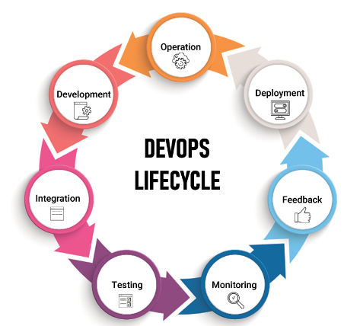
Traditional DevOps
Development – The Planning and Coding of Software, preferably in small cycles of work to ensure speed of delivery.
Continuous Integration (CI) – The phase for integrating new features and bug fixes into the development process.
Testing (QA) – Testing phase for bugs, errors, and usability.
Continuous Deployment (CD) – Ensures the automated deployment of a system. Here is where Containerization and Configuration Management holds a lot of value to ensure success.
Continuous Monitoring – Identify use patterns, performance issues, and system health.
Continuous Feedback – Feedback loops are essential in all stages of the lifecycle for our success.
Operation – Your processes have worked, and your system is operational. Let’s repeat.

Slide 7
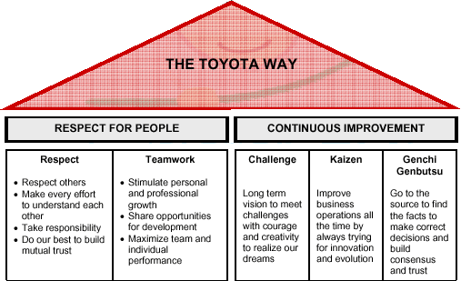
The Lean House: The Toyota Way

Slide 8
The Agile Manifesto
We are uncovering better ways of developing software by doing it and helping others do it.
Through this work we have come to value:
Individuals and interactions over processes and tools Working software over comprehensive documentation Customer collaboration over contract negotiation Responding to change over following a plan
That is, while there is value in the items on the right, we value the items on the left more.

Slide 9
DevOps: The Three Ways
The 1st Way:
FLOW
Work Visibility
Eliminate Waste
The 2nd Way:
FEEDBACK
Right to Left
Embed Knowledge
The 3rd Way:
CULTURE
Continual Experimentation
Deming (PDCA)
CI/CD
Monitoring
Faster Feedback
Repetition and Practice
Blameless Culture
Improve At Constraints

Slide 10
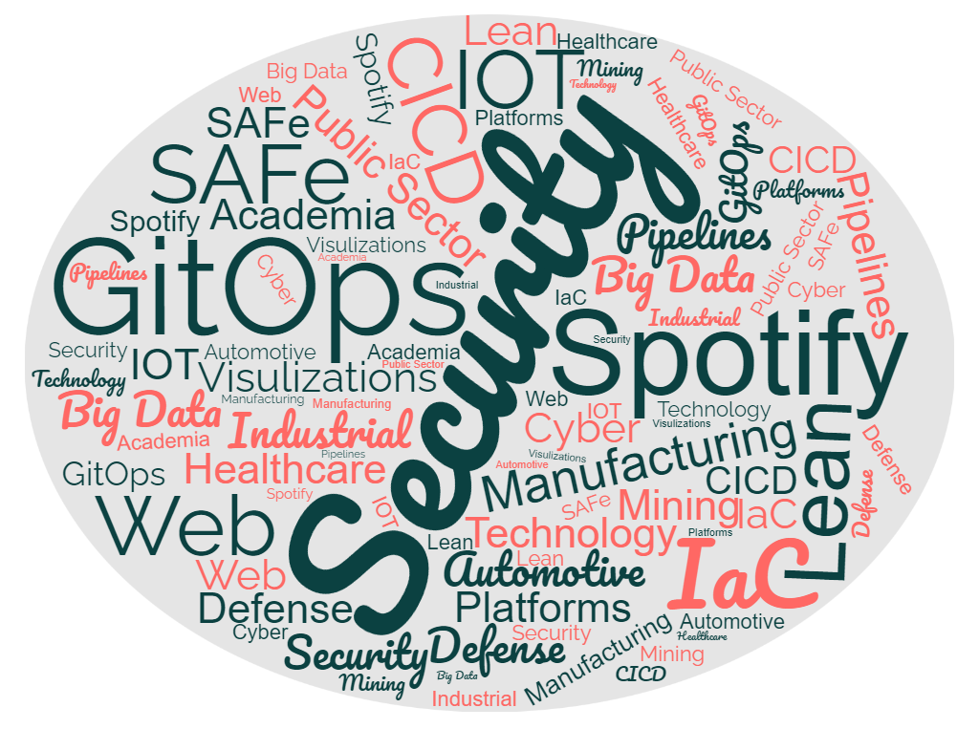
Modern DevOps: Not just about Software Delivery

Slide 11
Modern DevOps: Real World Use Cases
At a Fortune 100 Mining Company: Enabled our miners to have access to visual data to make faster decisions, saving lives and money.
For HR Team: Created a pipeline process that allowed us to modernize the onboarding steps by standardizing hardware and software configurations based on job role. This included automating all hardware ordering and software configuration.
MSP Operations:
1. Used DevOps tools and processes to create a fully orchestrated customer delivery system of cloud resources.
2. Developed a Dev/Test/Prod approach to how we work in customer environments.

Slide 12
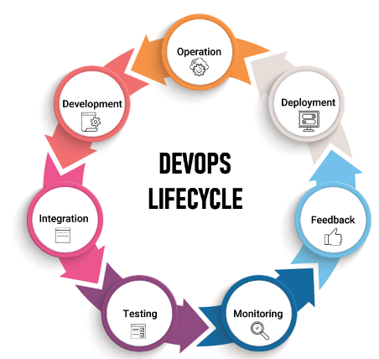
Modern DevOps: Then What Is It?
Modern DevOps: Is the enablement of high-quality value delivery throughout the Enterprise by empowering people, utilizing advanced technology solutions, and embracing systems thinking.
The 3 Ways
Feedback Loops – Tear down silos! Collaborate. Help each other.
Understand Flow – Doesn’t matter the job you are in. Learn the upstream and downstream processes.
Work Visibility – Keep work visible. This can’t be stated enough. You want to connect data and people as often as possible. This enables all most all other key items to their highest levels.
Dev/Test/Prod – Use the idea of dev/test/prod workflows in other areas of the Enterprise.
X as Code – If it can be treated as, or like, code – do it!
Kaizen! (Your Secret Word) – Think about process improvement forever and always.

Slide 13
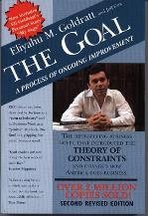
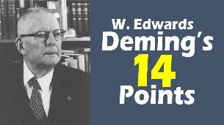
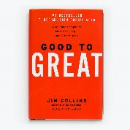
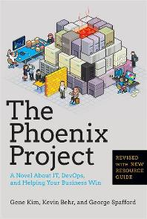
Readings and Educational Recommendations
READINGS:
Frederick Taylor, The Principles of Scientific Management
Dr. W. E. Deming, Out of the Crisis
Taichi Ohno, Workplace Management
Dr. Shigeo Shingo, Kaizen and the Art of Creative Thinking
Dr. Eliyahu Goldratt, The Goal
Jeffery Liker, The Toyota Way
Steven C. Bell, Lean IT: Enabling and Sustaining Your Lean Transformation
Jim Collins, Good to Great
Patrick Lencioni, The Five Dysfunction of a Team
Gene Kim, The Phoenix Project
Kelsey Hightower, Brendan Burns, Kubernetes: Up and Running
EDUCATION ENDEAVORS:
AWS, Cloud Practitioner > Solutions Architect and/or Developer Associate
AZURE, Azure Fundamentals > Azure Administrator and/or Developer Associate
CONTAINERS (REDHAT), Introduction to Containers, Kubernetes, and Red Hat OpenShift
CICD (JENKINS – Cloudbees.com), Essentials > Administration > Pipelines
LeanIT (PeopleCert), Foundations > Kaizen
A Cloud Guru – Totally awesome paid training site with some of the best IT training I’ve every had.

